Slide 1
Session 03
Bitcoin
Blockchain Protocols and Decentralized Applications

Slide 2
Discussions
Paper: https://bitcoin.org/bitcoin.pdf
Hashing
Cryptography
Signatures
Timestamped Append-only Logs (Blocks)
Merkle Trees
Consensus through Proof of Work
Network of Nodes
Bitcoin

Slide 3
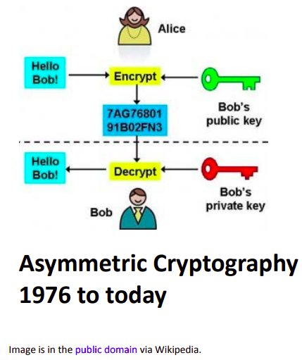
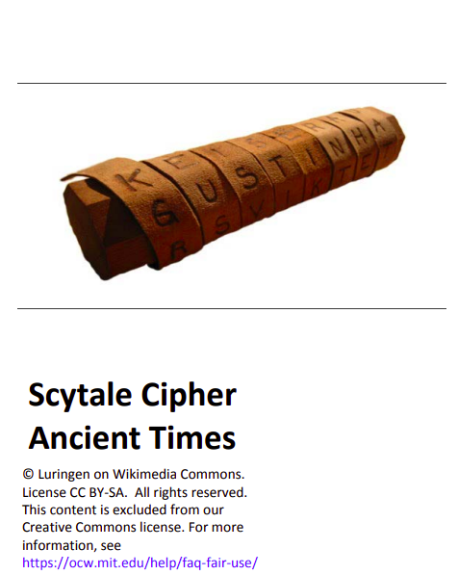
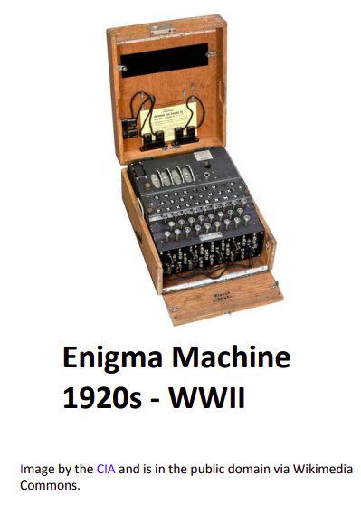
Cryptography
Communication in presence of adversaries

Slide 4
Cryptographic Hash functions
Maps any data (from one string to an entire hard disk) to an Output called “HASH” with fixed size
Properties
Deterministic - same result every time
Efficient - fast computation
Preimage resistant (One way): infeasible to determine x from Hash(x)
Collision resistant: infeasible to find and x and y where Hash(x) = Hash(y)
Avalanche effect: Change x slightly and Hash(x) changes significantly
Used in blocks, addresses

Slide 5
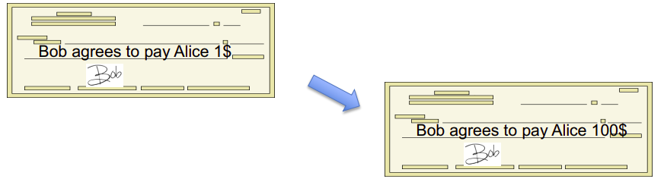
Signatures
Physical signatures: bind transaction to author
Problem in the digital world
anyone can copy Bob’s signature from one doc to another

Slide 6
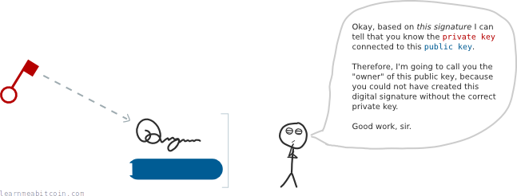
Digital Signatures
Prove that private key match public key

Slide 7
Digital Signatures (2)
RSA
DSA
Elliptic Curve Digital Signature Algorithm (EDCSA) - Bitcoin
significantly shorter private and public keys to achieve the same level of security

Slide 8
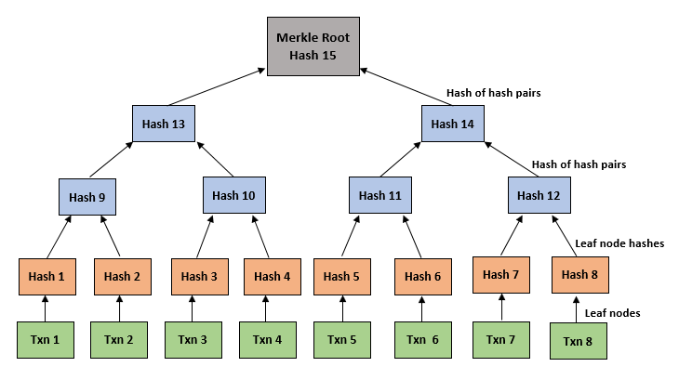
Merkle Trie
https://arxiv.org/abs/2209.13431

Slide 9
Bitcoin
Electronic cash
Online payments
No financial institution
Prevent double-spending
Using peer-to-peer
Proof-of-work
Nodes can leave and rejoin the network
Whitepaper

